Slide 1
Big Mountain ticket analysis

Slide 2
Problem Identification
Problem Statement: Was the increase of the operating cost for distributing visitor between different trails and charging a premium price for skiing the best business model. Is there a better price option that maximize the visitor visiting the facilities.
Context: It has yearly visitor of 350,000 for skiing and snowboarding. Was the investment in additional chair lift correct?
Criteria: Big Mountain needs to validate if their pricing is maximizing their investments. With adjustments of additional ski lifts. Big Mountain should be able accommodate an additional 10% of visitors.
Scope of the solution space
Validate if the pricing needs to be increase or decrease.
What amenities will increase ticket pricing.

Slide 3
Recommendation and key finding
The data analysis of the ticket of $81 can be increased to $95.87 due to the modeling and show the amenities will support this increase.
Big Mountain Resort should increase their price, currently it is below market price
With the additional to chair lift and increase ticket price, we can support an addition revenue. I found that every $1.99 price increase we can add an additional $3,474,638 of revenue.* The additional chairlift would support this increase
*Found in our model 5.9.3 scenario 2 and 3

Slide 4
Modeling
Big Mountain Adult ticket weekend is the highest in Montana.
Big Mountain is amongst the resorts with the largest amount of skiable terrain.
Big Mountain is doing well for vertical drop, but there are still quite a few resorts with a greater drop.
Big Mountain is very high up the league table of snow making area.
Most resorts have no fast quads. Big Mountain has 3, which puts it high up that league table.
The vast majority of resorts, such as Big Mountain, have no trams.

Slide 5
Modeling cont.
Big Mountain has amongst the highest number of total chairs, resorts with more appear to be outliers.
Big Mountain compares well for the number of runs. There are some resorts with more, but not many.

Slide 6
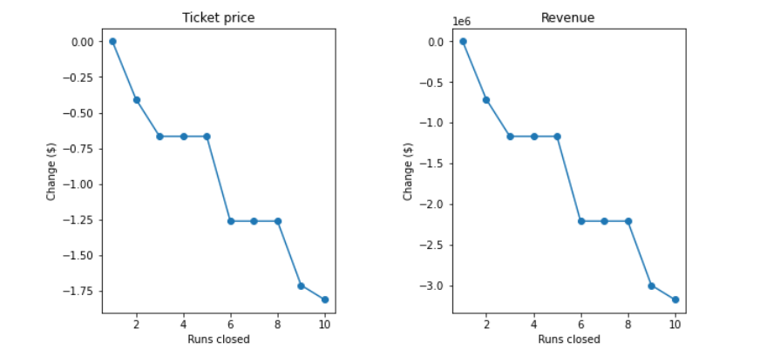
Modeling cont… Scenario model for increasing revenue
If we try to close 10 of least use run affects ticket price. Closing of up 5 runs or more affect the ticket price by 1% percent and revenue by 1%
Increase the longest run by 0.2 mile to boast 3.5 miles length, requiring an additional snow making coverage of 4 acres but does not support an increase of ticket price

Slide 7
Conclusion
Current price is $81.00 in Big Mountain Resort, but modelling price suggests for $95.87.
After analyzing the amenities of Big Mountain Resort, I believe we are below market value for ticket price.
The additional operating cost of chair lift would support additional revenue of $3,474,638. This will pay for the investment within 1 season.
Model suggest future investment should be done in Snow Making. We would need to add 2 acre of snow making to increase ticket price of $1.99

